Slide 1
Operating Systems Overview
CS 3100
Week 1

Slide 2
What is an Operating System?
Some years ago an operating system was defined as the software that controls the hardware.
However, the landscape of computer systems has evolved significantly, requiring a more complicated definition.
Applications are now designed to execute concurrently.
An OS can now be defined as a program that controls the execution of application programs, and an interface between applications and hardware

Slide 3
3 Operating System Objectives…
Convenience
  Makes the computer more convenient to use
Efficiency
  Allows computer system resources to be used in an efficient manner
Scalability
  Permit effective development, testing, and introduction of new system functions without interfering with service

Slide 4
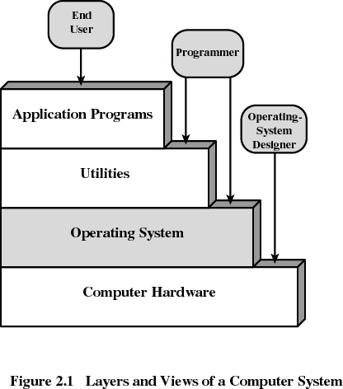
Layers of Computer System

Slide 5
Services Provided by the Operating System
Program development
  Editors and debuggers
Program execution
Access to I/O devices
Controlled access to files
System access
Error Detection and Response
Accounting

Slide 6
Operating Systems…
Function same way as ordinary computer software
  They are programs that are executed
Operating systems relinquish control to the processor to execute other programs, and depend on the processor to regain that control.

Slide 7
Kernel
Portion of operating system that is in main memory
Contains most-frequently used functions
Also called the “nucleus”

Slide 8
Evolution of Operating Systems
Serial Processing (1940’s - 50’s)
  No operating system
  Machines ran from a console with display lights and toggle switches, input device, and printer
  Scheduled time
  Setup included loading the compiler, source program, saving compiled program, and loading and linking

Slide 9
Evolution of Operating Systems
Batch Systems (1950’s – 60’s)
  Monitors (Simple Operating Systems)
    Software that controls the running programs
    Batch jobs together
    Resident monitor is in main memory and available for execution
    The rest of the monitor consists of utilities and common function subroutines
    Program branches back to monitor when finished

Slide 10
Enhancements to Monitors
Memory protection
  do not allow the memory area containing the monitor to be altered
Timer
  prevents a job from monopolizing the system
Interrupts
  Gives the operating system more flexibility in relinquishing and regaining control from user programs

Slide 11

…but, Uniprogramming (Batch) was still inefficient!
Processor must wait for I/O instruction to complete before preceding

Slide 12
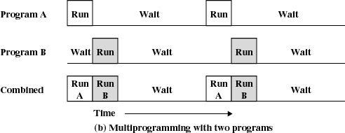
Multiprogramming (or Multitasking) Introduced
When one job needs to wait for I/O, the processor can switch to the other job

Slide 13
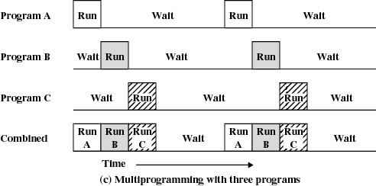
Multiprogramming

Slide 14
Time Sharing (Today)
Using multiprogramming to handle multiple interactive jobs
Processor’s time is shared among multiple users
Multiple users simultaneously access the system through terminals

Slide 15
Major Achievements in the past 25 years…
Concept of “Processes”
Better Memory Management
Information protection and security
Better Scheduling and resource management
System structure and architecture

Slide 16
1. The concept of Processes
A program in execution
An instance of a program running on a computer
The entity that can be assigned to and executed on a processor
A unit of activity characterized by a single sequential thread of execution, a current state, and an associated set of system resources

Slide 17
Processes made designing the OS more difficult
Improper synchronization
  ensure a process waiting for an I/O device receives the signal
Failed mutual exclusion
Nondeterministic program operation
  program should only depend on input to it, not relying on common memory areas
Deadlocks

Slide 18
Processes (The Foundation)
Consists of three components
  An executable program
  Associated data needed by the program
  Execution context of the program
    All information the operating system needs to manage the process

Slide 19
2. Memory Management
Process isolation
Automatic allocation and management
Support for modular programming
Protection and access control
Long-term storage

Slide 20
Memory Management: Virtual Memory
Allows programmers to address memory from a logical point of view
While one process is written out to secondary storage and the successor process read in - there is no hiatus

Slide 21
Memory Management: File System
Implements long-term storage
Information stored in named objects called files

Slide 22
Memory Management: Paging
Allows process to be comprised of a number of fixed-size blocks, called pages
Virtual address is a page number and an offset within the page
Each page may be located any where in main memory
Real address or physical address in main memory

Slide 23
Memory Management: Dynamic Mapping
Eliminated the requirement that all pages reside in main memory simultaneously.
Memory management hardware detects and arranges for missing page to be loaded.

Slide 24
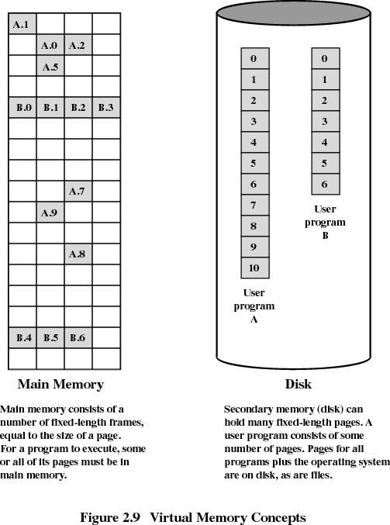

Slide 25
3. Information Protection and Security
Access control
  regulate user access to the system
Information flow control
  regulate flow of data within the system and its delivery to users
Certification
  proving that access and flow control that performs according to specifications

Slide 26
4. Scheduling and Resource Management
Fairness
  give equal and fair access to all processes
Differential responsiveness
  discriminate between different classes of jobs
Efficiency
  maximize throughput, minimize response time, and accommodate as many uses as possible

Slide 27
5. Enhanced System Structure
View the system as a series of levels
Each level performs a related subset of functions
Each level relies on the next lower level to perform more primitive functions
This decomposes a problem into a number of more manageable sub problems

Slide 28
Characteristics of Modern Operating Systems TODAY
Microkernel architecture
  assigns only a few essential functions to the kernel
    address space
    interprocess communication (IPC)
    basic scheduling
  Other processes handled by “Servers”

Slide 29
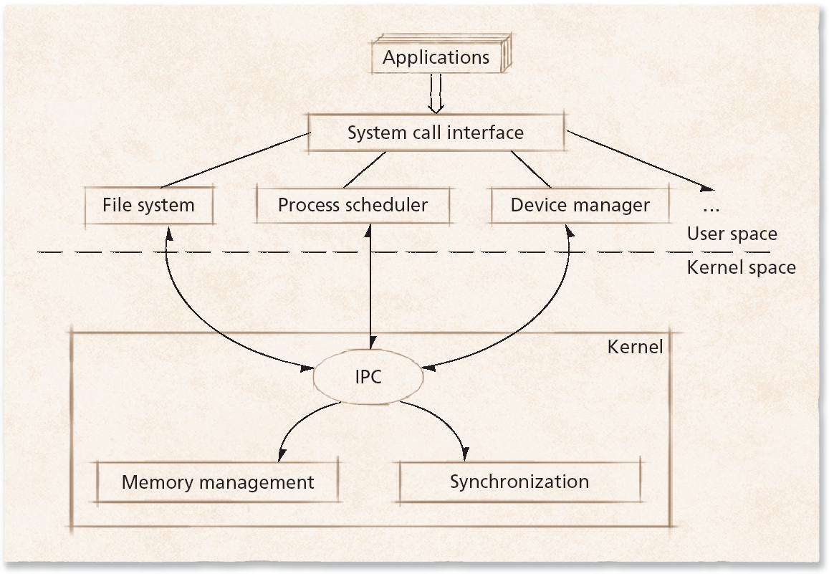
Microkernel

Slide 30
Characteristics of Modern Operating Systems (cont)
Multithreading
  process is divided into threads that can run simultaneously
Thread
  dispatchable unit of work
  executes sequentially and is interruptible
Process is a collection of one or more threads

Slide 31
Characteristics of Modern Operating Systems (Cont)
Symmetric multiprocessing (SMP)
  there are multiple processors
  these processors share same main memory and I/O facilities
  All processors can perform the same functions

Slide 32
Characteristics of Modern Operating Systems (Cont)
Distributed operating systems
  provides the illusion of a single main memory and single secondary memory space
  used for distributed file system

Slide 33
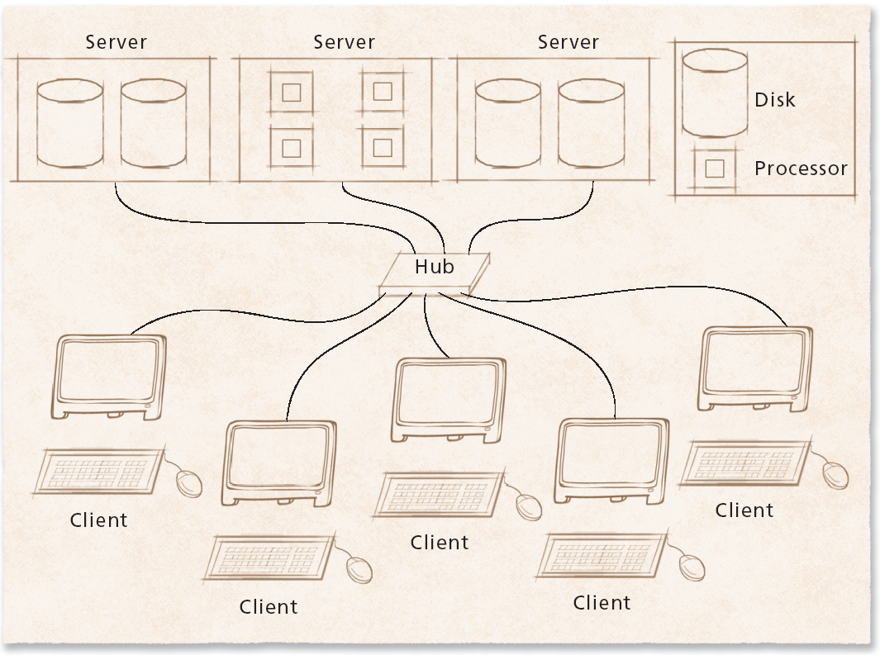
Distributed Operating System

Slide 34
Characteristics of Modern Operating Systems (Cont)
Object-oriented design
  used for adding modular extensions to a small kernel
  enables programmers to customize an operating system without disrupting system integrity
  Layered Approach

Slide 35
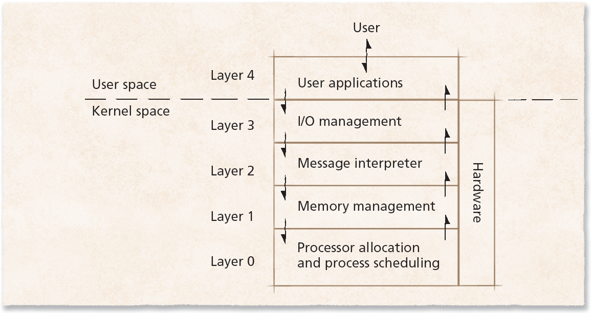
Layered Architecture

